Slide 1


QR CODE ENABLED APPOINTMENT BOOKING SYSTEM FOR FUTO ICT CENTRE
IBEAKANMA DABERECHUKWU OLUEBUBECHUKWU
20191153822
SUPERVISOR: REV. ABRAHAM OVWONURI

Slide 2

INTRODUCTION
Higher education institutions are the bedrock of societal progress, but they are increasingly suffering from growing administrative pressures in managing the administrative processes, especially as they tend to become bigger and more complex. As one of the top technological universities in Nigeria, the Federal University of Technology Owerri (FUTO) is challenged with the administrative challenges of an immense student community. The administrative difficulties are clearly most pronounced in high-contact environments such as the ICT center, the registrar’s office, and student affairs offices, where students congregate to address academic, technical, and administrative problems.

Slide 3

PROBLEM STATEMENT
Administrative work at FUTO is currently limited by several inefficiencies impacting both students and staff, namely student congestion in administrative offices, insufficient task delegation, obsolete student verification techniques, and overall student discomfort. Congestion, especially at the ICT center under high load, leads to significant waiting time, frustration, and decreased staff productivity.

Slide 4

MAIN OBJECTIVES
Reduce Overcrowding – Implement an appointment system to minimize congestion at ICT centers and administrative offices.
Efficient Complaint Management – Allow students to log complaints, which are automatically assigned to available staff based on expertise.
Automated Scheduling & QR-Based Ticketing – Provide students with scheduled time slots and generate QR-coded PDF tickets for verification.
Enhanced Security & Authentication – Implement Identity authentication to ensure only verified users access the system.
Data Management & Reporting – Maintain digital records, track complaints, and generate reports to improve administrative efficiency.

Slide 5
SPECIFIC OBJECTIVES
1.Create an online platform for students to schedule appointments and generate QR code for verification.
2.Automate task allocation based on staff availability and expertise.
3.Enable students to make appointments within time slots to avoid conflicts.
4.Develop an on-site QR code verification system for identity and appointment verification.
5.Assess the effects on reduction of waiting time, workload management, and patient satisfaction of the system.

Slide 6
METHODOLOGY
The implementation of the FUTO Appointment Booking System based on QR Code Technology was driven by the use of the Agile approach in a Solo-Scrum environment. This methodology guaranteed iterative and intent driven design and development cycle allowing ongoing integration of feedback and modifications based on evolving requirements.

Slide 7
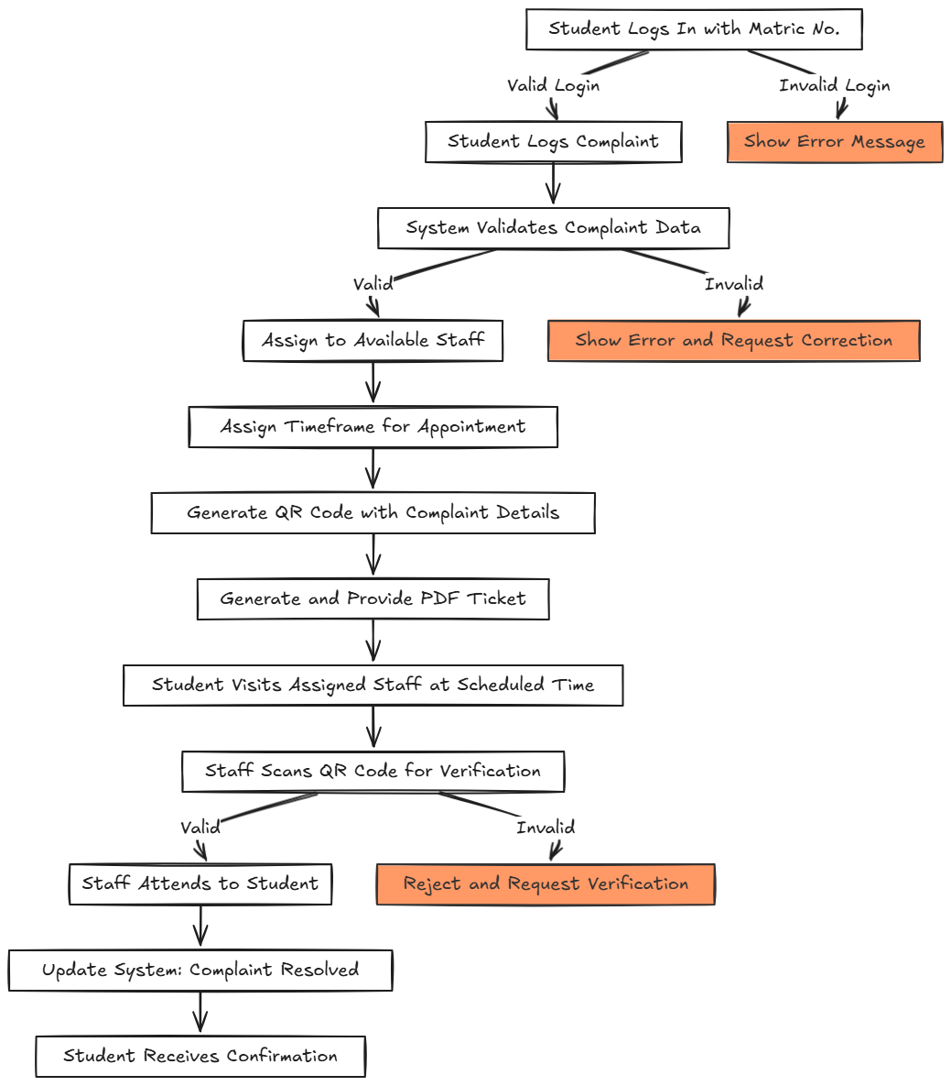
DESIGN AND IMPLEMENTATION

Slide 8
RESULTS/FINDINGS
The system is predicted to significantly alleviate crowding at service centres by optimizing administrative efficiency and also providing a convenient platform for users to make appointments and monitor activities. The presence of QR codes allows for exact confirmation, minimizes errors during manual verification, and does not necessitate physical queuing. Additionally, the iterative approach of Agile development ensures that the system meets user needs while remaining scalable and adaptable for future enhancements.

Slide 9
CONTRIBUTION TO KNOWLEDGE
This Appointment Booking System contributes to knowledge by introducing digital transformation in university complaint and appointment management. It applies a 3-tier architecture in ASP.NET Core MVC, ensuring scalability and maintainability. The system integrates QR code-based verification for authentication and AI-driven staff allocation to optimize workload distribution. By bridging the gap between theory and real-world implementation, it serves as a reference model for future research in automated scheduling, service optimization, and digital verification. Additionally, its foundation can be expanded into machine learning for predictive analytics and blockchain for tamper-proof complaint logging.

Slide 10

QUESTIONS?

Slide 11

Thank you for listening

